Slide 1

Information Systems (II)
LECTURE 2

Slide 2
Operating Systems

Slide 3
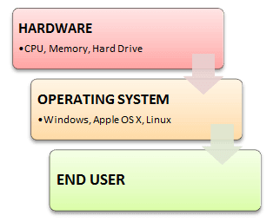
What is an Operating System?
An operating system is a software which acts as an interface between the end user and computer hardware.
Every computer must have at least one OS to run other programs. An application like Chrome, MS Word, Games, etc needs some environment in which it will run and perform its task.
The OS helps you to communicate with the computer without knowing how to speak the computer's language. It is not possible for the user to use any computer or mobile device without having an operating system.

Slide 4
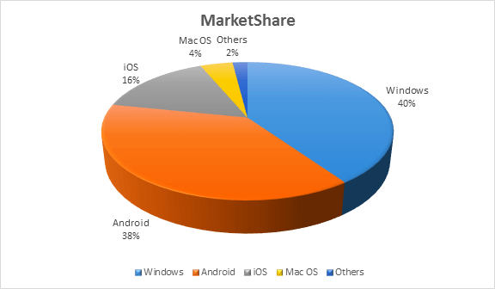
Examples of OS with Market Share

Slide 5
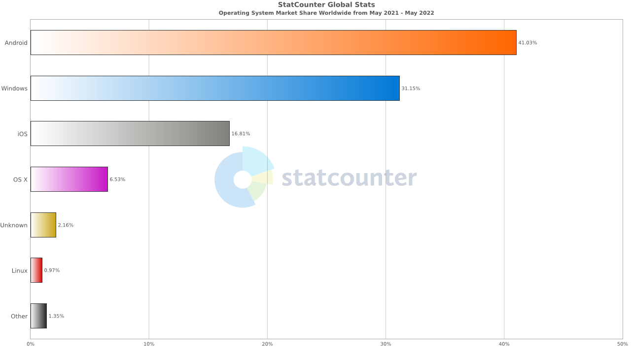

Slide 6
History Of OS
Operating systems were first developed in the late 1950s to manage tape storage
The General Motors Research Lab implemented the first OS in the early 1950s for their IBM 701
In the mid-1960s, operating systems started to use disks
In the late 1960s, the first version of the Unix OS was developed
The first OS built by Microsoft was DOS. It was built in 1981 by purchasing the 86-DOS software from a Seattle company
The present-day popular OS Windows first came to existence in 1985 when a GUI was created and paired with MS-DOS.

Slide 7
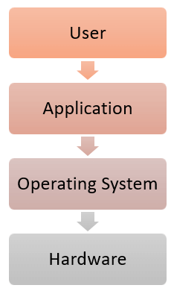
Features of Operating System
Protected and supervisor mode
Allows disk access and file systems Device drivers Networking Security
Program Execution
Memory management Virtual Memory Multitasking
Handling I/O operations
Manipulation of the file system
Error Detection and handling
Resource allocation
Information and Resource Protection

Slide 8
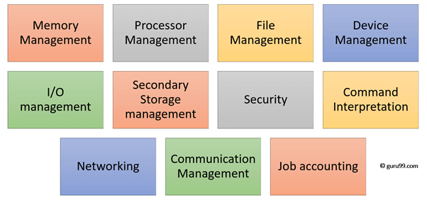
Functions of an Operating System

Slide 9
Functions of an Operating System
Process management: Process management helps OS to create and delete processes. It also provides mechanisms for synchronization and communication among processes.
Memory management: Memory management module performs the task of allocation and deallocation of memory space to programs in need of this resources.
File management: It manages all the file-related activities such as organization storage, retrieval, naming, sharing, and protection of files.
Device Management: Device management keeps tracks of all devices. This module also responsible for this task is known as the I/O controller. It also performs the task of allocation and deallocation of the devices.
I/O System Management: One of the main objects of any OS is to hide the peculiarities of that hardware devices from the user.

Slide 10
Functions of an Operating System
Secondary-Storage Management: Systems have several levels of storage which includes primary storage, secondary storage, and cache storage. Instructions and data must be stored in primary storage or cache so that a running program can reference it.
Security: Security module protects the data and information of a computer system against malware threat and unauthorized access.
Command interpretation: This module is interpreting commands given by the and acting system resources to process that commands.
Networking: A distributed system is a group of processors which do not share memory, hardware devices, or a clock. The processors communicate with one another through the network.
Job accounting: Keeping track of time & resource used by various job and users.
Communication management: Coordination and assignment of compilers, interpreters, and another software resource of the various users of the computer systems

Slide 11
Types of Operating system
Batch Operating System
Multitasking/Time Sharing OS
Multiprocessing OS
Real Time OS
Distributed OS
Network OS
Mobile OS

Slide 12
Types of Operating system
Batch Operating System
Some computer processes are very lengthy and time-consuming. To speed the same process, a job with a similar type of needs are batched together and run as a group.
The user of a batch operating system never directly interacts with the computer. In this type of OS, every user prepares his or her job on an offline device like a punch card and submit it to the computer operator.

Slide 13
Types of Operating system
Multi-Tasking/Time-sharing Operating systems
Time-sharing operating system enables people located at a different terminal(shell) to use a single computer system at the same time. The processor time (CPU) which is shared among multiple users is termed as time sharing.
Real time OS
A real time operating system time interval to process and respond to inputs is very small. Examples: Military Software Systems, Space Software Systems.
Distributed Operating System
Distributed systems use many processors located in different machines to provide very fast computation to its users.

Slide 14
Types of Operating system
Network Operating System
Network Operating System runs on a server. It provides the capability to serve to manage data, user, groups, security, application, and other networking functions.
Mobile OS
Mobile operating systems are those OS which is especially that are designed to power smartphones, tablets, and wearables devices.
Some most famous mobile operating systems are Android and iOS, but others include BlackBerry, Web, and watchOS.

Slide 15
The advantage of using Operating System
Allows you to hide details of hardware by creating an abstraction
Easy to use with a GUI
Offers an environment in which a user may execute programs/applications
The operating system must make sure that the computer system convenient to use
Operating System acts as an intermediary among applications and the hardware components
It provides the computer system resources with easy to use format
Acts as an intermediary between all hardware and software of the system

Slide 16
Cloud Computing

Slide 17
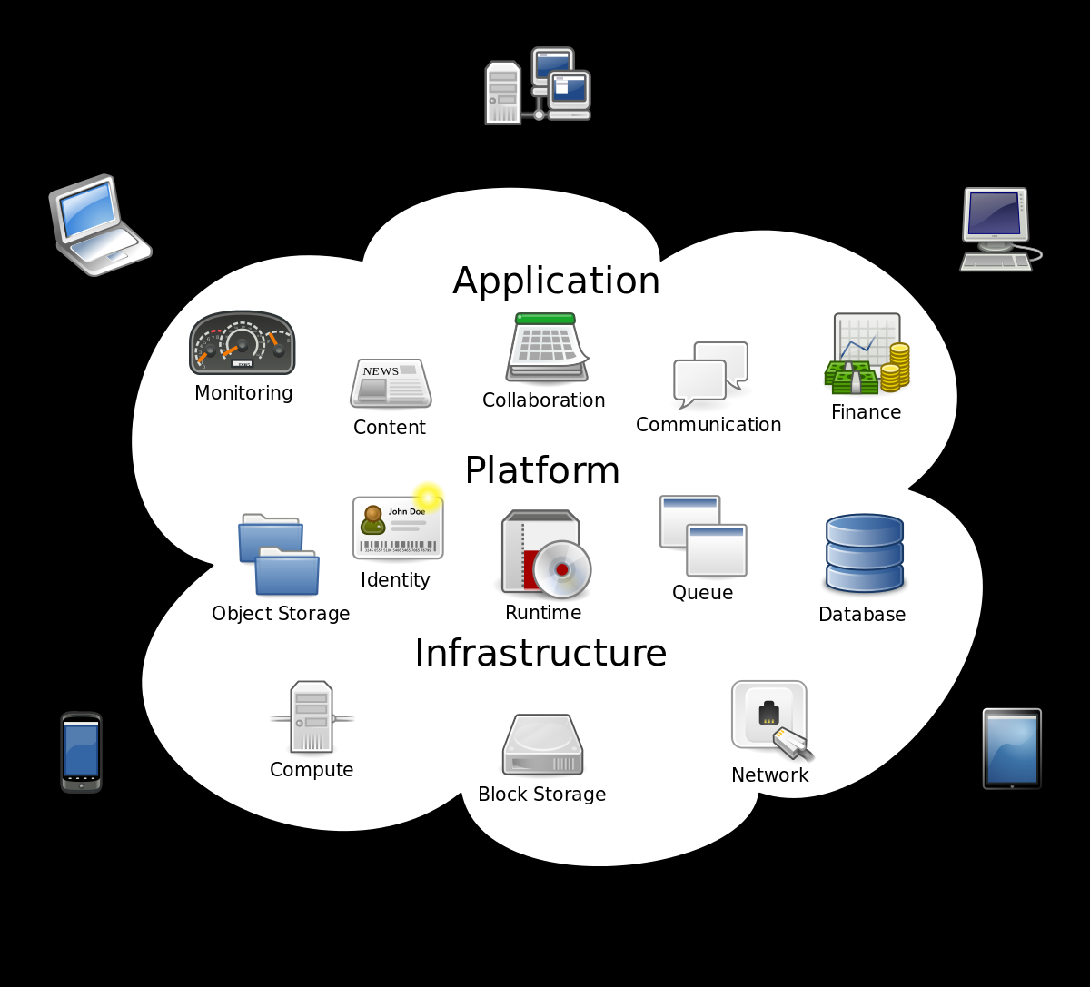
Cloud Computing
What is cloud?
“The cloud” refers to applications, services, and data storage on the Internet.
Examples:
E-mail, Google drive, One drive, Salesforce (CRM)

Slide 18
Advantages of Cloud Computing
No software to install or upgrades to maintain.
Available from any computer that has access to the Internet.
Can scale to a large number of users easily.
New applications can be up and running very quickly.
Services can be leased for a limited time on an as-needed basis.
Your information is not lost if your hard disk crashes or your laptop is stolen.
You are not limited by the available memory or disk space on your computer.

Slide 19
Disadvantages of Cloud Computing
Your information is stored on someone else’s computer – how safe is it?
You must have Internet access to use it. If you do not have access, you’re out of luck.
You are relying on a third-party to provide these services.

Slide 20
Using a Private Cloud
Many organizations are understandably nervous about giving up control of their data and some of their applications by using cloud computing.
But they also see the value in reducing the need for installing software and adding disk storage to local computers.
A solution to this problem lies in the concept of a private cloud.
While there are various models of a private cloud, the basic idea is for the cloud service provider to section off web server space for a specific organization.
The organization has full control over that server space while still gaining some of the benefits of cloud computing.

Slide 21
Computer Network

Slide 22
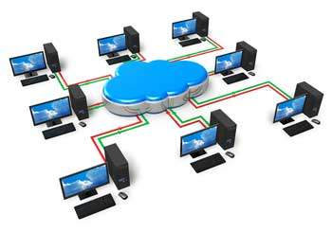
Computer Network
A computer network is a system in which multiple computers are connected to each other to share information and resources.
Characteristics of a computer network
  Share Resources from one computer to another
  Create files and store them in one computer, access those files from the other computer(s) connected over the network
  Connect a printer, scanner, or a fax machine to one computer within the network and let other computers of the network use the machines available over network.

Slide 23
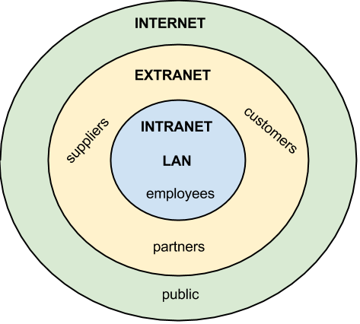
Organizational Networking

Slide 24
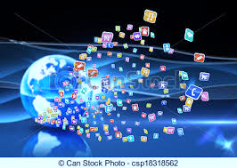
Computer Applications in Society
What are some examples of computer applications in society?
  Education
  Finance
  Government
  Health Care
  Science
  Publishing
  Travel
  Manufacturing

